Slide 1
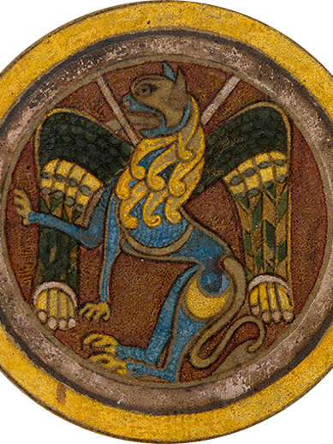
XXIX CORSO INTERNAZIONALE DI
FORMAZIONE BIBLIOGRAFICA
Medioevo latino.
Metodologie e tecniche bibliografiche
Firenze, SISMEL
27 – 31 ottobre 2025

Slide 2
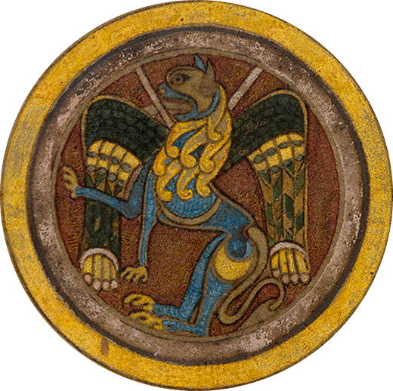
what is it?
Medioevo latino is an annual bibliography, which lists scientific publications about medieval subjects published in the previous year; it is mainly related to the texts written in Latin between the year 475 and the beginning of the sixteenth century. The publication comes out on a regular basis since 1980, for a total of forty six volumes (forty-seventh was launched in July 2025)
Medioevo latino is promoted by SISMEL (Società internazionale per lo Studio del Medioevo Latino)
the bibliography is the result of systematic, comprehensive and direct examination of books, journals, and newsletters relating to medieval Latinity and, in general, to medieval culture and history.
there are particular and specialized bibliographies devoted to the Middle Ages, «Medioevo latino» is characterized by its general scope (each topic is covered, to the exclusion of history of art and archaeology)
the distinctive feature of the bibliographic information provided by «Medioevo latino» is the presence in the vast majority of entries of a guiding synthesis (abstract) of the content of the various studies reported.
«Medioevo latino» configure itself as a structured bibliography, meaning with that the grid of parts, sections, subsections and individual entries in the index of the journal in its many subdivisions that therefore are the privileged access to the information contained in the annual volume and in the data base that collects all the numbers of «Medioevo latino»

Slide 3
how is it done?
the harvesting of the material to be published into the annual volume is carried by more than one hundred and fifty collaborators, for the most part belonging to thirty-one redactions, twenty-three in Italian universities: Bologna, Bologna-Ravenna, Florence, Foggia, Genoa, Genoa-Trento, Lecce (two redactions), Milan (two redactions), Naples (three redactions), Macerata, Perugia, Padua, Rome (two redactions), Salerno, Sassari, Siena, Turin, Udine, and eight foreign: Bonn, Columbus, OH, Göttingen, Lisboa, Paris, Santiago de Compostela, Valladolid, Zurich. In addition, there are various individual collaborations in Italy and abroad (eg in Barcelona, Las Vegas, Paris, and Wolfenbüttel)
at the end of their work, redactions and contributors send the collected material to the «Redazione centrale» (editorial staff) based in Florence. Here the material is corrected and prepared for printing

Slide 4
Its history and evolution
the first volume of «Medioevo latino» appeared in the summer of 1980. Behind there was a preparatory work that took about two years: from an initial suggestion of Francesco Della Corte received by Claudio Leonardi, a group of Italian scholars - Rino Avesani, Ferruccio Bertini, Giuseppe Cremascoli and Giovanni Orlandi to which was added almost immediately Giuseppe Scalia - was formed; it was committed to give shape to the general plan of the work, determine the characteristics and ensure the publication
the model of the structure was that of the «Année philologique»: a section devoted to authors and texts at the beginning and than sections relating to various subjects
over the years, the first internal structure of «Medioevo latino» has undergone numerous changes. There was no change to the two parts that contain the bibliography about medieval authors and anonymous texts and the ancient authors in the medieval tradition (the «Fortleben»), but the remaining material was already reorganized in the early numbers. This permanent reorganization is a work in progress carried out several times in the long history of «Medioevo latino»
the initial orientation still remains strong in the presence, on top of the volume, of the parts relating to authors and texts and in the importance given in the abstracts to philological aspects (manuscripts, autography, attributions, etc.)

Slide 5
the new technologies: the beginning
the volumes of «Medioevo latino» I-XII (1980-1991) have been published in accordance with traditional methods (ie as books)
1992: publication of the first number, the XIIIth, realized with a program written in Clipper developed for the operating system MS-DOS. The program allowed the insertion of the bibliographical items and the production of the volume for printing (including indexes) as a text file, without any formatting
1993: beginning of the entry in the database of volumes I-XII; process ended in 1994
1993-1994: writing of a new program for the management of all data (both the annual volume, and the volumes published before and after); the SW has been developed for the Windows operating system using the FoxPro development environment

Slide 6
the new technologies in the new century
2001: writing of the first version of the SW currently in use and beginning of the realization of the integrated database (AIM = Archivio integrato per il medioevo) that now runs not only «Medioevo latino», but also all the scientific projects promoted by SISMEL and Fondazione Ezio Franceschini. The very nature of new technologies and the experience gained led to the substantial update of the system, integrating «Medioevo latino» with other researches of SISMEL and Fondazione Franceschini. The SW is a web-based application that does not depend on the client's operating system and requires no installation. It can be used from any computer with any web browser. The technology used is ASP with SQL Server database
2009: publication of the site «Mirabile» (http://www.mirabileweb.it/); beginning of the online publication of «Medioevo latino» with other projects promoted by SISMEL
2010: renovation of the integrated archive (especially for the entry forms of authors, works, anonymous texts, and manuscripts) with increased functionality for the entry and amount of information
2012: publication of a new version of Mirabile (Mirabile2) with more archives and the presence of projects devoted to vernacular literature; greater flexibility in presenting information; presence of projects promoted by other institutions besides SISMEL and Fondazione Franceschini
2012-2013: renovation of the integrated archive (AIM) aiming mainly at a greater flexibility in the management of individual projects (autonomy / integration; profiling of collaborators, etc.)

Slide 7
the new technologies in the new century
2014: new version of Mirabile including some new projects with increased search capabilities and a new view of the bibliographic records of Medioevo latino aimed at greater clarity and usability of information.
2016: Mirabile update with the addition of a new project, MADOC (Manuscripta doctrinalia - XIII-XV centuries), and the transfer of the project MAGI already published as a book in 2007 (Rossana Eugenia Guglielmetti I testi agiografici latini nei codici della Biblioteca Medicea Laurenziana Firenze, SISMEL. Edizioni del Galluzzo 2007, Quaderni di «Hagiographica» 5)
2018-2023: new search engine, Elasticsearch (https://www.elastic.co/), open source, which allows, in addition to greater breadth, flexibility and speed of queries, even greater ease in implementing new features
2022: in AIM new data entry form for both an author's and anonymous works implemented as part of the OPA project (https://site.unibo.it/anonimi-medievali/it; https://sites.google.com/view/opa-unisa/home; https://dium.uniud.it/it/ricerca/opa/opa-opere-perdute-anonime/)

Slide 8

Archivio integrato per il medioevo
Integrated archive for the Middle Ages (AIM)
Archives available in AIM and already published in Mirabile
Medieval Latin DB
MEL | Medioevo latino
BISLAM | Bibliotheca Scriptorum Latinorum Medii Recentiorisque Aevi
MEM | Medioevo musicale
CALMA | Compendium Auctorum Latinorum Medii Aevi
OPA | Opere perdute e anonime – Universities of Bologna, Salerno e Udine)
CANTICUM | Census of manuscripts containing commentaries on the Song of Songs)
RICABIM | Repertorio di Inventari e Cataloghi di Biblioteche Medievali
ABC | Antica biblioteca camaldolese
ROME | Repertorio degli omeliari del medioevo
TeTRA | Medieval Latin Texts and their Transmission
TRAMP | La trasmissione testuale dei Padri latini tra mondo classico e medievale
MADOC | Manuscripta doctrinalia
New_CODEX | Catalogue of the Medieval manuscripts owned by Tuscan libraries and institutions (except for State libraries)
AdriHum | Humanistic Cultural Territories across the Sea (University of Macerata): 2024

Slide 9
Archivio integrato per il medioevo
Integrated archive for the Middle Ages (AIM)
Romance DB
LIO | Lirica Italiana delle Origini
BAI | Biblioteca Agiografica Italiana
MAFRA | Repertorio dei manoscritti gallo-romanzi esemplati in Italia
TECOLM | Testi e codici della Lombardia medievale
TRALIRO | Repertorio ipertestuale della tradizione lirica romanza delle Origini
ArsNova | ERC Advanced Grant: European Ars Nova. Multilingual Poetry and Polyphonic Song in the Late Middle Ages
EMAF 15-16 | Éditer le Moyen-Âge français aux XVe-XVIe siècles
Medioevo latino #<numero>

Slide 10
Archivio integrato per il medioevo
Integrated archive for the Middle Ages (AIM)
Hagiographic DB
MATER | Manoscritti Agiografici di Trento e Rovereto
BAI | Biblioteca Agiografica Italiana
MAGI | Manoscritti Agiografici della Biblioteca Medicea Laurenziana
PALMA | Passionaria Latina Medii Aevi
MAGIS | Manoscritti Agiografici dell’Italia del Sud

Slide 11
Archivio integrato per il medioevo
Integrated archive for the Middle Ages (AIM)
Not yet published in Mirabile
GREGORIO | Census of manuscripts of Gregory the Great
MLAC | Medieval Latin Aristotles Commentaries - SISMEL
RDP | Rime disperse di Petrarca - Université de Genève
Vaticinia | data-base of medieval prophecies and predictions - SISMEL-OPA, 2024
TGC | The ancient world seen from medieval glosses (Seminar für Griechische und Lateinische Philologie - University of Zurich)
GLAM | Glossaria Latina Aevi Medii (University of Milan)

Slide 12
Features of the integrated archive
it is an unified system that allows both separate management of individual activities and their integration in the use of common data and the uniform citation of these, avoiding checks that would be repeated within each research
the main elements in common: names of medieval authors, titles of their works, titles of anonymous texts, and manuscripts
whatever is the project that introduces these elements, they are immediately visible and can be used by other researches

Slide 13
Interaction with the collaborators that implement the database of «Medioevo latino»
collaborators are provided of a personal website for data entry (the so-called «bussolotto»)
they are administrators of their site, so every function is active (they may create a new record in every list, edit and delete records entered)
data from personal sites are imported into the central data-base through a special SW that also indicates to the editorial staff any new element inserted by collaborators in the lists (the so-called «report»). The editorial staff will provide to check the correctness of the data, possibly modifying them, after a check on the data already present in the various databases

Slide 14
The MEL form for data entry
The main feature (also from the point of view of the working method) is the presence of lists in most fields (scholars, medieval authors, titles, place of publication, publishing houses, periodicals, series, indexes of manuscripts, places, scholars, etc.). The lists correspond to archives variously articulated (consisting of a single field eg. index of places or with an articulated structure as the index of manuscripts)

Slide 15
Analysis of «Medioevo latino» structure
Part one: Authors and texts
chronology: from ca. 475 till Erasmus and Copernicus)
language: Latin; for medieval authors until the beginning of the fourteenth century that are bilingual - eg. Notker Teutonicus - all literary production, both Latin and in the vernacular, is considered; for humanists, including Dante, Petrarch and Boccaccio only the Latin texts are considered)

Slide 16
Analysis of «Medioevo latino» structure
Part two: Fortleben
Tradition (Fortleben) of ancient and patristic authors in the Middle Ages
Tradition (Fortleben) of biblical texts in the Middle Ages

Slide 17
Analysis of «Medioevo latino» structure
Part three
macro-section dedicated to medieval disciplines
linguistic and literary macro-section
macro-section dedicated to literary genres
historical-institutional macro-section
macro-section devoted to aspects of spirituality and cultural history
section dedicated to the history of the medievistic discipline

Slide 18
Analysis of «Medioevo latino» structure
Part four: Auxiliary sciences of history
Part five: Reference
Part six: Miscellaneous works and reports of conferences

